Slide 1
How do gamblers chase losses? Evidence from online gambling data
Ke Zhang
Notes:
In this presentation, I will introduce two sets of data that demonstrate a classic phenomenon in gambling, called loss-chasing. The data were collected both from laboratory studies and an actual online gambling form, so using this complementary methods, hopefully I can give a you a good overview about this phenomenon.

Slide 2
Loss-chasing in gambling
Loss-chasing: the tendency to increase betting in order to recover prior losses.
Between-session: if the gambler returns another day to recoup losses (DSM-V); often the most item in screening tools for gambling disorder (Hodgins et al., 2011).
Notes:
Loss-chasing is when people bet more in order to recover their losses.
So why I called loss-chasing a “classic”, because it’s one of the diagnostic symptoms in the DSM, and it’s also the most commonly endorsed item, 80% of PG endorsed it. In the DSM, loss-chasing is worded as “if the gambler returns another day to recoup losses”. We would called it as “between session chasing” because the pattern of “increase betting” happens across gambling sessions.
Alternatively, chasing can happen within a single gambling session. For instance, when the gambler increases the bet size over the course of the gambling session; or they bet longer. These patterns are also logically sound if the gambler try to win their money back, however, not many gambling studies collected such behavioural data.
________________________________________________________________
(Q: Difference between-within? Transition from recreational to PG is increased between-session chasing (e.g., 60% recreational gamblers endorsed between-session, 80% PG endorsed it). Account closers (due to problems) increased bet size as the day closed to the closure)

Slide 3
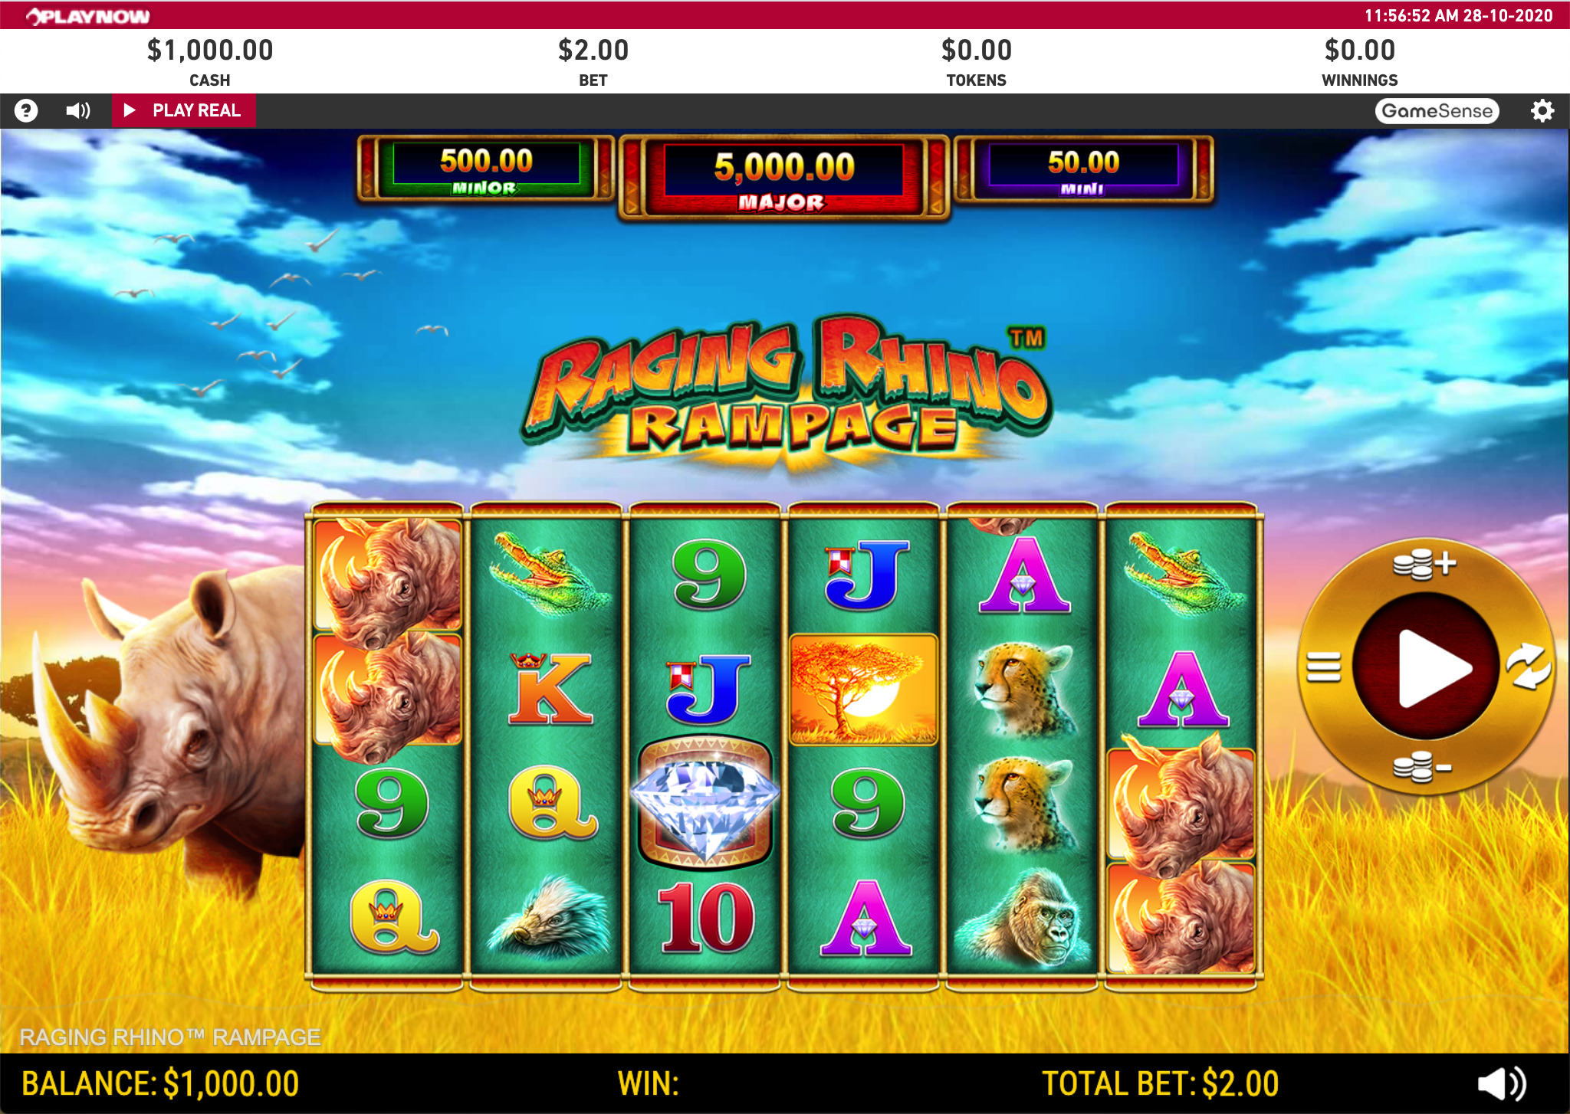
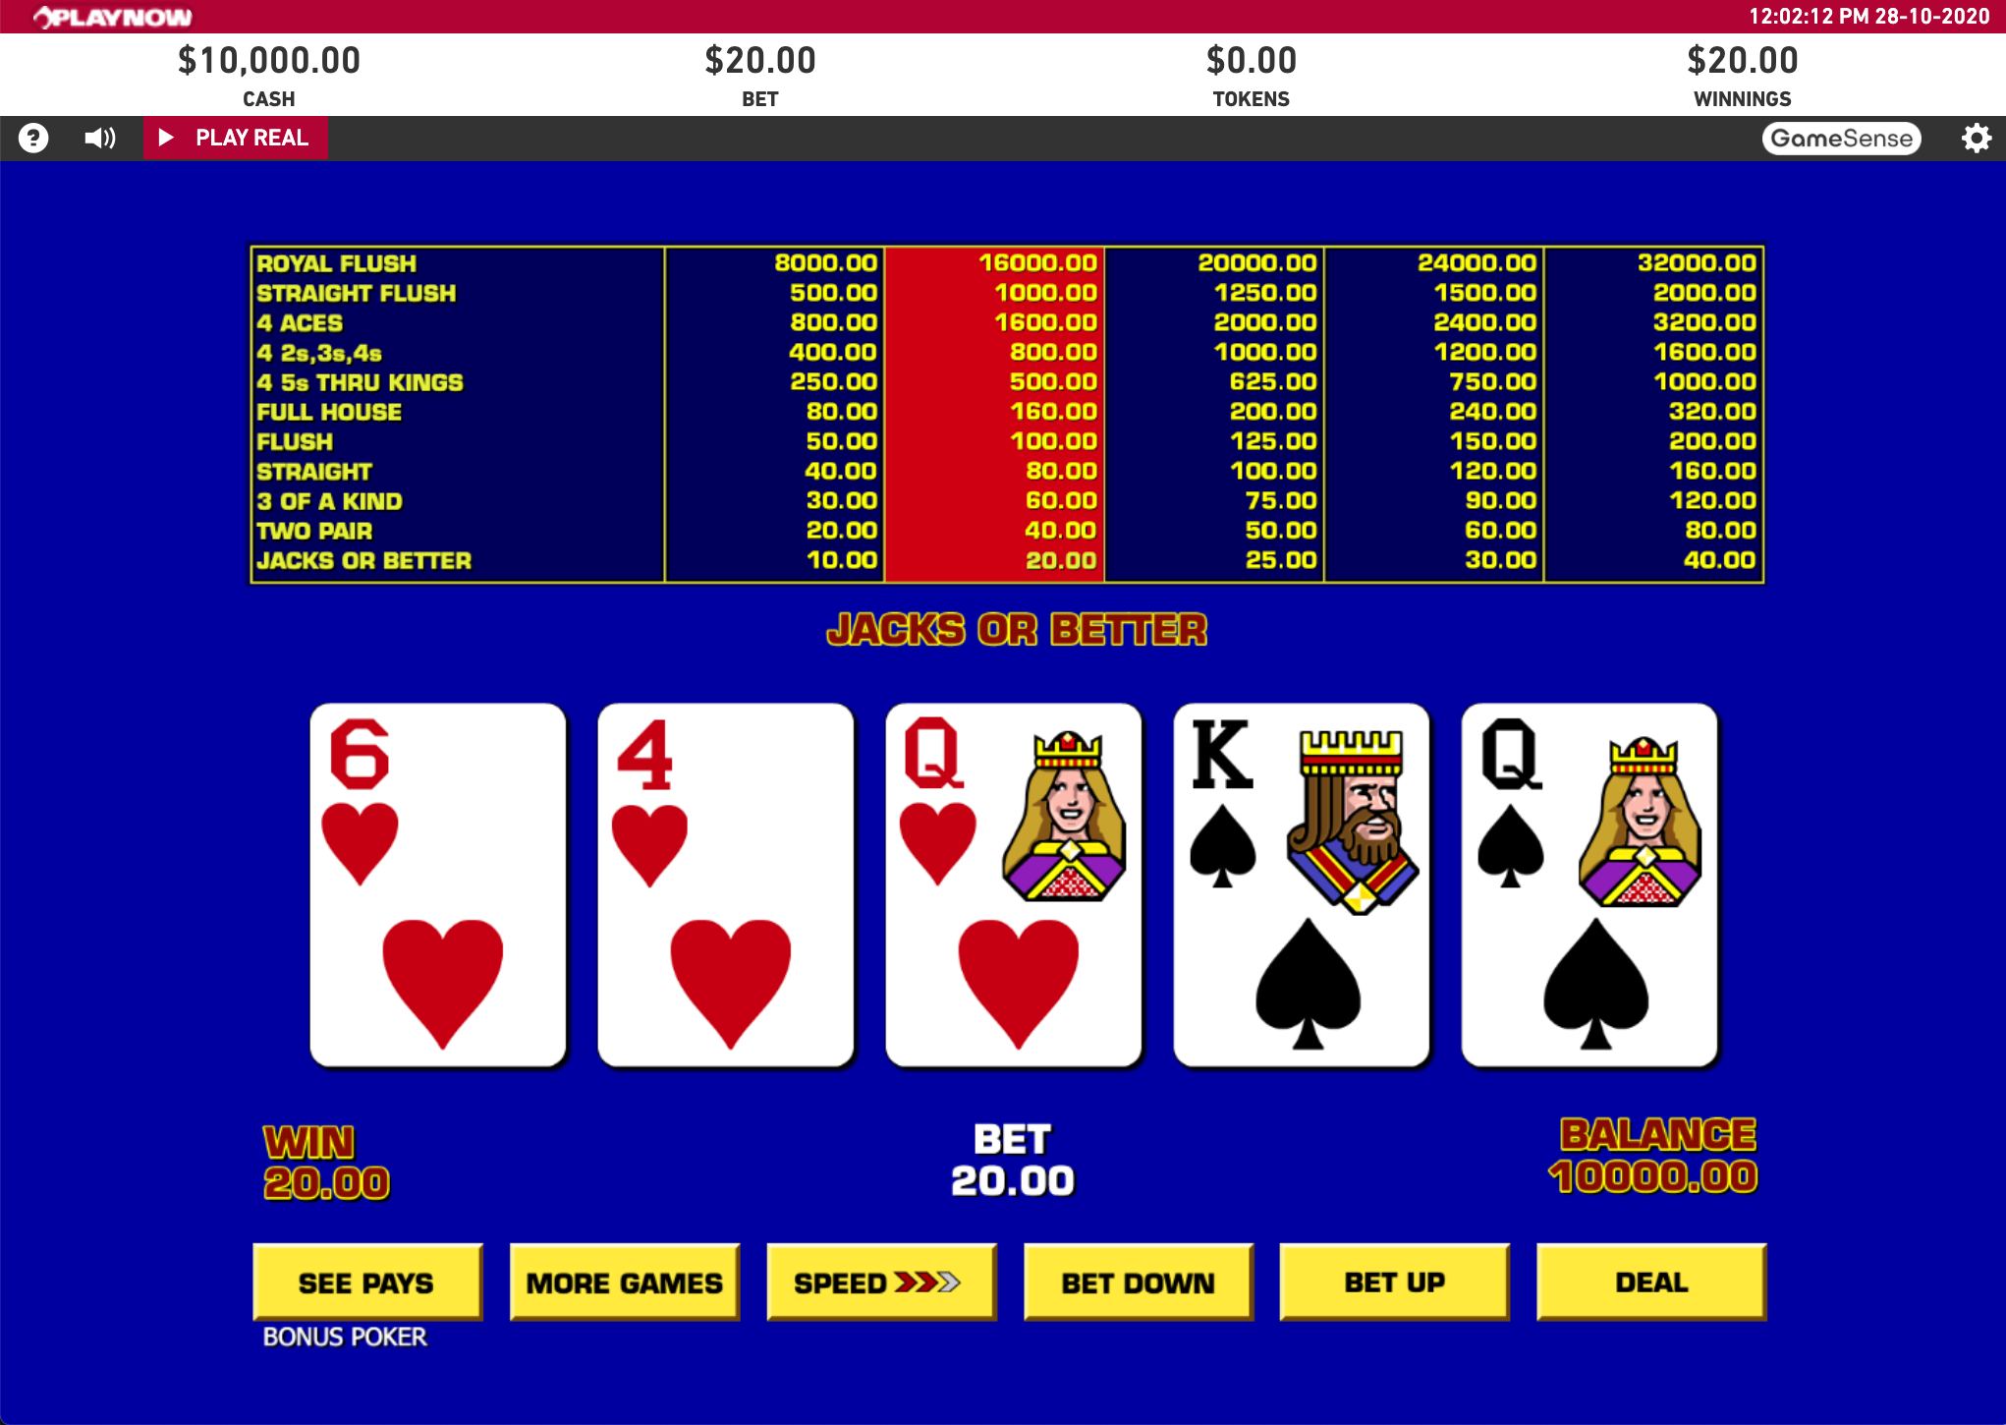
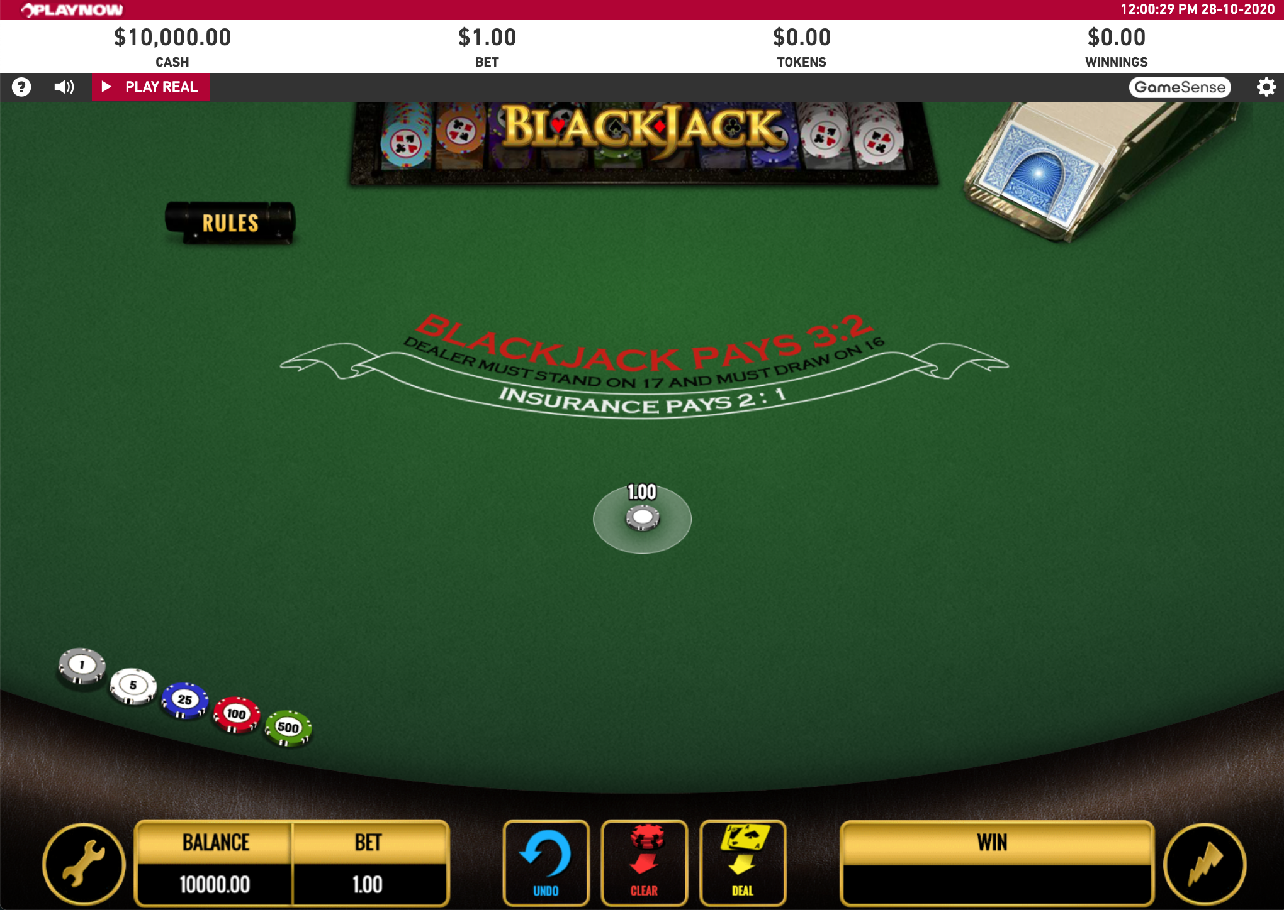
Online gambling data
Betting behaviour tracked on the PlayNow.com
Inclusion criteria:
April 2015, BC residents
Users must have played >1 session in slots, table games, video poker (No mixed-game session)
Users must have played < 200,000 bets (3SD outliers)
135,330 gambling sessions from 9,775 unique users
109,230 slots sessions
21,520 table games sessions (e.g., blackjack, roulette)
4,580 video poker sessions
Notes:
- The analysis used the bet-by-bet behaviour tracked on the playnow website, which the BC online gambling platform. Gamblers have to take the losses from their own pocket, instead of hypothetical losses in the lab, so that will give us more insight on realistic loss-chasing.
This analysis included one-month betting data in April 2015; these users played at least 1 session in slots, tables games, and video poker and we also excluded users who bet extremely more as outliers
In the end, we have over 100 thousand gambling sessions from just under 10 thousand unique users. And users played slots in most sessions and least in video poker.

Slide 4
Questions
Does the magnitude of total losses in the prior session predict the time interval between gambling sessions?
How does this loss-chasing tendency vary by slots, video poker, table games?
Slots and video poker: play continuously at a fast pace and accumulate loss quickly
Table games: require intentional moves (e.g., count cards, placing bets on numbers)
Notes:
For this data set, our questions are first, does the magnitude of the total loss in the prior session predict the time interval between the gambling session? A shorter time interval to the next session indicate a higher urgency to chase losses.
Second, how does this chasing tendency vary the 3 games?
Slots and video poker are fast pace games, technically you can keep pressing the same button to continue betting and thus they accumulate losses quickly. Whereas table games such as roulette and blackjack, they require intentional moves and they have more flexibility in bets , such as you need to place your bet on numbers, so they are slower paced games.
So these different game attributes may contribute to the urgency of returning to platform in order to losses.
(fixed bet (default): slots
Table games: changing bet, and more flexibility of bets, require intentional moves)

Slide 5
Analysis
Data structure
Multilevel Modeling clustering users:
IVs = Prior total loss, Game, Interaction
DV = Time interval
(Generalized Linear Mixed Model)
user id
Sessional data:
Prior total loss
Time interval
Game
Notes:
To introduce the analysis briefly, we basically run a multilevel modelling due to the nature of the data set. The sessional data, including prior total loss, time interval to the next session, and game type are all clustered within a user.
the predictors are prior total loss, game, and their interaction term, the DV is the time interval between gambling sessions. We ran generalized linear model with these terms with the random factor of user id.
(The link function provides the relationship between the predictor and the mean of the distribution function.
OLS is the DV normal distribution
Why use Gamma GLM here?
Generalized linear mixed model, the gamma distribution with a log link
Scaled prior total loss
DV = Time interval (positive-only and positively skewed)

Slide 6
Descriptive sessional data
Notes:
Here are the descriptive data. In slots, users lost $64.24 on an average session, that were significantly more than table games and video poker sessions.
In terms of the time interval to the next session, table games players took the longest time to return the platform – 13 hrs, then followed the slots players, which took 12.68 hours, then the video poker players took the shortest time to return, about 10.55 hour
Kruskal–Wallis: one-way ANOVA on ranks

Slide 7
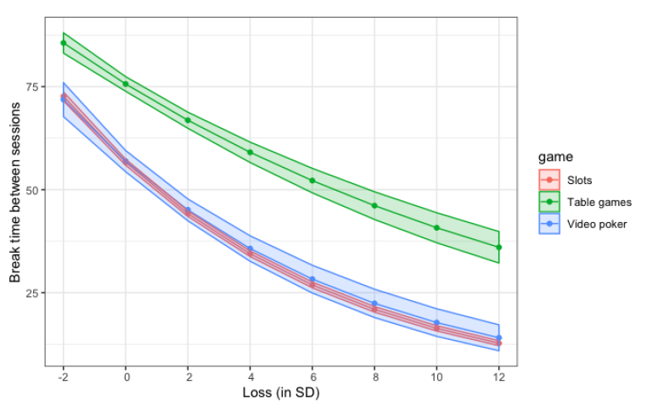
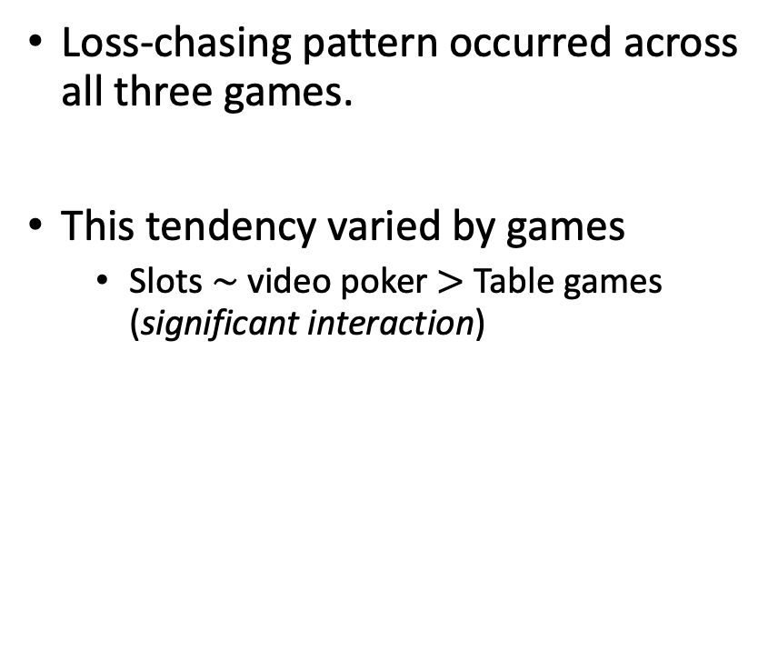
Results
Prior total loss x games
Loss-chasing pattern occurred across all three games.
This tendency varied by games
Slots $\sim$ video poker $>$ Table games (significant interaction)
Time interval between sessions (in hour)
Notes:
- The graph here shows how time interval to the next session changed by the prior loss across the 3 games. The y-axis is time interval between sessions in hours, x-axis showed a standardized loss. Loss at 0 is the average loss of a session. Right to the 0 means a loss more than the average, left to the 0 means a loss less than the average, but doesn’t means it’s a win.
Overall, all three lines are in the downward sloping, meaning users reduced time interval to the next session as they lost more, that is what we called between-session loss-chasing. Table games had longer time interval between sessions overall across losses.
This chasing tendency varied by games. The slopes are similar in video poker and slots (blue and read lines here), meaning their chasing pattern is similar. Whereas the table games have a gentler slope than the slots and video poker, meaning that an additional unit increase in loss induced a longer time interval relative to the other two, so table games chased less urgently .

Slide 8
Conclusion
Does the prior total loss predict the time interval between sessions?
Typical loss-chasing pattern across all three games; increased prior total loss shortened the time interval to the next session.
How does this loss-chasing tendency vary by games?
Between-session loss-chasing was less urgent in table games than slots and video poker
Slots and video poker: fast-pacing games - are more addictive.
Land slots gambling is the most addictive gambling game, but no data compared e-casino slots and video poker.
Notes:
In conclusion, we do see that a loss-chasing pattern between sessions across games, a larger loss induced a shortened time interval to the next session
Furthermore, this loss-chasing tendency varied by games. The chasing was less urgent in table games than slots and poker
It may because that slots and video poker are more fast-pacing games and may accumulated loss faster, hence users returned faster. In that sense, we may argue that the two are more addictive form of gambling games than table games.
Also, we often argued that slots in land based casino is the most addictive gambling games, here we see an evidence that slots is also addictive online in terms of chasing. But rarely data compared online games, especially no data directly compared slots and video poker. Given the all land based casino are closed in some capacity due to pandemic, it’s a good chance to dive more into the online gambling

